Slide 1
Classes
CMPE2300
Winter 2014
JD Silver

Slide 2
Classes
Classes provide additional functionality over structures.
Classes continue the concept of encapsulation and provide, additionally, inheritance and polymorphism.
You will typically create your class definitions in a separate source file, and will place the class definition within the same namespace as your main project.
Classes share some similarity with structures.
A significant difference is that an instance of a structure is a value type, while an instance of a class is a reference type.

Slide 3
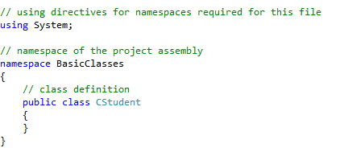
Classes

Slide 4
Classes
The new class type must be marked as internal or public.
If you intend for the class to be only used by your main project only, mark it as internal.
if the class needs to be accessible to other modules, mark it as public.

Slide 5
Classes
Classes will usually contain fields that will hold data.
It is considered a good programming practice to make the class field data inaccessible outside the class.
This is done by marking the fields as private, internal or protected.
At this time, until the topic of inheritance is covered, use private.

Slide 6
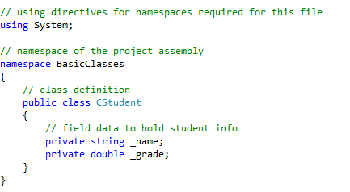
Classes

Slide 7
Instance Constructors
Instance constructors are used in initialize a class or structure with values when an instance is created.
Constructors are methods take the name of the class or structure, and have no return data type.
The purpose of a constructor is to properly initialize the member data of an instance.
Since constructors need to be accessed by other parts of the program, they are typically declared as public.

Slide 8

Default Constructor
When you create a class, a default constructor is created automatically.
The default constructor takes no parameters.
The default constructor initializes all reference type field data to null, and value type field data to 0.
The default constructor is called when the new operator is used to create an instance of a class.

Slide 9
User-Defined Constructors
The default constructor is limited to initializing instance field members to null or 0.
Typically a class will contain at least one user-defined constructor that can provide initial value to the field members.
If you create a user-defined constructor, the creation of the default constructor is suppressed.
User-defined constructors are typically declared as public.

Slide 10
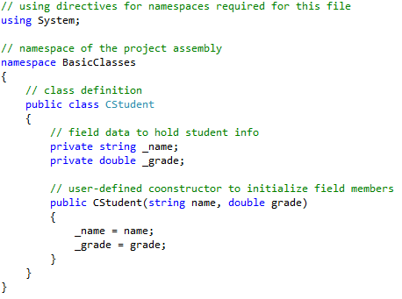
User-Defined Constructors

Slide 11

User-Defined Constructors
The field members can be initialized when the new operator is used to create an instance of the class.

Slide 12
User-Defined Constructors
Your class may contain multiple constructors, as long as each function signature contains a unique set of parameter types, modifiers and ordering.
Note that the return data type cannot be used to differentiate overloaded methods.

Slide 13
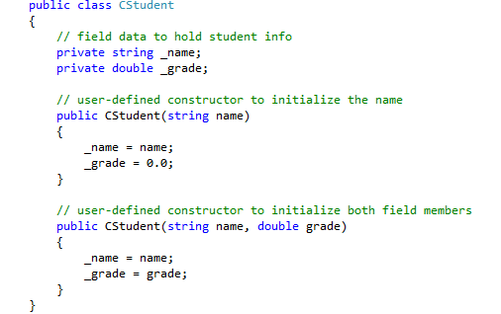
User-Defined Constructors

Slide 14
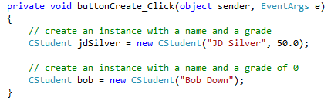
User-Defined Constructors
In the example below, two instances of CStudent are created using each constructor.

Slide 15
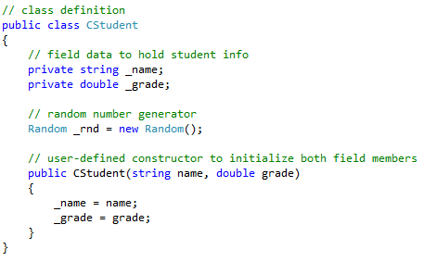
User-Defined Constructors
If a field does not require specific initialization in a constructor, it is acceptable to create the instance for that field in the declaration.

Slide 16
Invoking Constructors
A constructor may invoke another constructor to save repetition of code.
The this operator provides a reference to the current instance, which can be used to invoke an existing constructor.
The call to an existing constructor is made after a colon on the same line as the method definition.

Slide 17
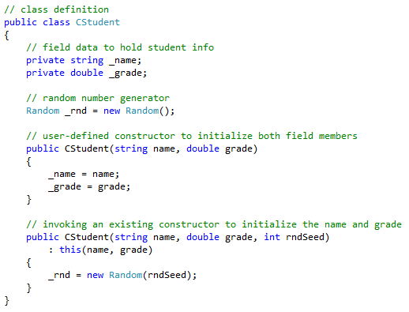
Invoking Constructors

Slide 18

this
The this keyword provides a reference to the current instance of the class.
It is available in every instance of a class.
It can be used to resolve ambiguous names in a class. For example, if a class member shares the name of a function parameter, this can be used to access the class member.

Slide 19
Properties
A class should not expose field data as part of the public interface.
Access to the field data should be controlled to protect the integrity of instances of the class.
A property is a C# mechanism that facilitates controlled access to field data.
There are two types of properties, getters and setters.
The get property can be used to return the value of the field to the calling program.
The set property can be used to write a new value into a data field.

Slide 20
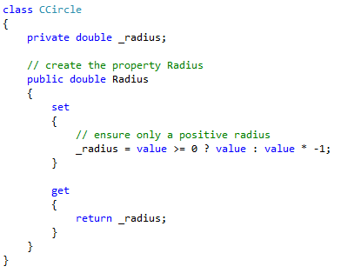
Properties

Slide 21
Properties
A property is usually public, since it provides the interface to the field variable.
The data type specified for the property is the type of data that is accepted or returned.
The name of the property usually starts with a capital letter, and it is the name that is used in the calling code.
Properties may consist of two parts, a setter and a getter.
Each part is defined in a block preceded by set or get.
When the user assigns a value to the property, the set block of code is executed.
When the user reads a value from the property, the get block of code is executed.

Slide 22
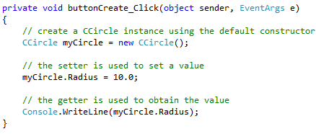
Using a Property
The calling program uses the properties to read or write data to the underlying field data.

Slide 23
Using a Property
When a property is used, code within the set or get section is executed.
You can add as much code that you wish to the get or the set blocks.
A property is not required to define both a getter and a setter block.
If you define only a setter, then the user will not be a to read the value from the property.
If you define only a getter, then the user will not be able to write to a property.
Setter code is typically used to verify that valid data is being stored by the object.

Slide 24
Automatic Properties
C# version 3.0 introduced automatic properties.
The property is declared as public, and a blank get and set statement is added.
A hidden, private variable is created for the class.
The properties are used both inside and outside the class to access the hidden variable.
Both the get and the set components must be defined for an automatic property.

Slide 25
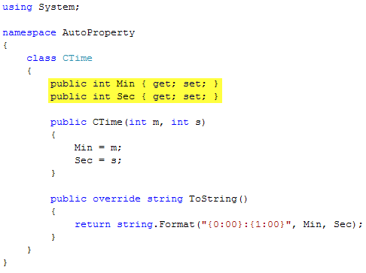
Automatic Properties

Slide 26
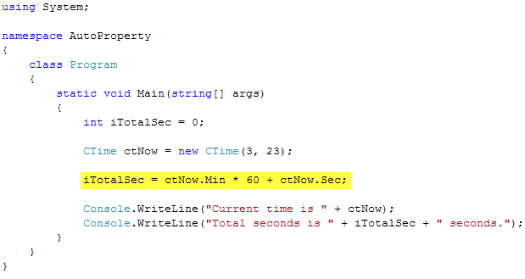
Automatic Properties

Slide 27
Automatic Properties
If you wish to protect the data values, the automatic properties can be created so that set can only be used within the class.
Declare the set automatic property to be private to prevent access to the data from outside the class.

Slide 28
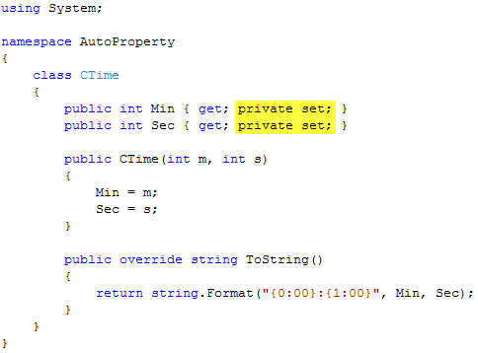
Automatic Properties

Slide 29
Automatic Properties
When defining automatic properties using the naming convention for a property: start with a capital letter, and leave out the _.

Slide 30
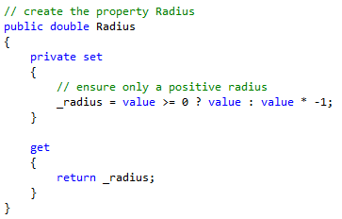
Properties
It is possible to place access modifiers on the get/set blocks of a property.
This is usually done to make the setter unavailable outside the class, but still present inside the class.

Slide 31
Properties
You must be careful not to attempt to violate the access level provided for the property when you set the access level for get and set.
The access level for get and set must be more restrictive than the property.

Slide 32
Static Members
A class or a struct may contain static members which are instance independent.
Static members are added to a class to provide functionality that is related to the that type, but not necessarily to the instance specific data.
Example: the Show method of the Messagebox class is static and does not require an instance of the class to be used.
Static methods are invoked by using the dot operator with the class name.
Creating a static method requires the use of the static keyword.

Slide 33
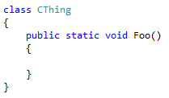
Static Members
Static methods cannot access non-static data since they are invoked without an instance.
A static method may not use the this reference.
In the example shown below, the method Foo is declared to be static.

Slide 34
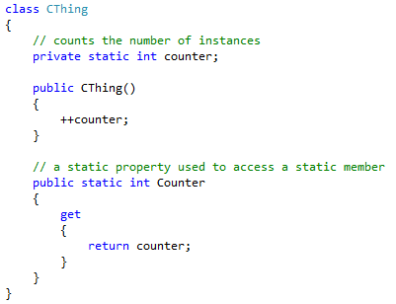
Static Members
Classes may create static fields which are instance independent, and shared amongst all instances of the class.

Slide 35
Static Members
In the example shown on the next slide, two instances of CThing are created, then the number of instances are displayed in a message box.

Slide 36
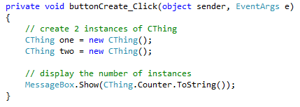
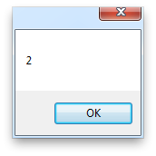
Static Members

Slide 37
Static Members
Non-static methods may access static and non-static fields, but static methods may only access static fields or methods.
A class may define one static constructor that is used to initialize static members.
This is only handy if you must initialize static members with data that is unknown at compile time.
Static constructors may not have access modifiers placed on them.

Slide 38
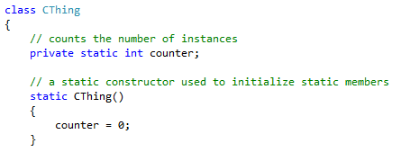
Static Members

Slide 39

Constant Data
Sometimes a class needs to define some constant data; for example, the Math class defines PI.
The simplest way is to declare a constant data field by using the const modifer.
The constant data must be initialized in the definition.

Slide 40
Constant Data
Constant fields are very useful for describing physical values that would rarely (or never) change.
A change to a constant field requires that the code be recompiled.
A constant field is inherently static.

Slide 41
Constant Data
Another option for creating constant data is to use a read-only field.
A read-only field can be assigned a value in a constructor, so its value can be determined at runtime.
Changing the value requires the creation of a new instance, but does not require that the code be recompiled.
Read-only fields are not inherently static, but can be made static with the use of the static keyword.
If you create a read-only static field, it must be initialized with an initializer or a static constructor.

Slide 42
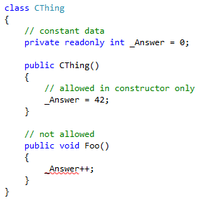
Constant Data

Slide 43
Overriding Equals
The Equals() method is often used to test for equality between two values or instances.
Checking for equality is different for value types and reference types.
For a value type, it means that the two objects contain the same value.
For reference types (instances of a class) it means that the object references are pointing to the same object.
Checking for equality is performed with Equals for value types, and ReferenceEquals for reference types.

Slide 44
Overriding Equals
If you have created a class that represents a logical value, then you should override Equals and provide logical meaning for two instances being equal.
Overriding Equals involves a few rules:
An object is equal to itself.
If x is equal to y, then y is equal to x.
The Equals method must not throw exceptions.
If Equals is overridden, then GetHashCode should also be overridden.
The Equals method returns a bool, and has a single parameter which is of type object.

Slide 45
Overriding Equals
In the following example, a class is used to define a drawing tile for a game.
Each tile will be placed at a point, and may be a circle or a square.
Equality will be determined by two objects being of the same class type, and containing the same point.

Slide 46
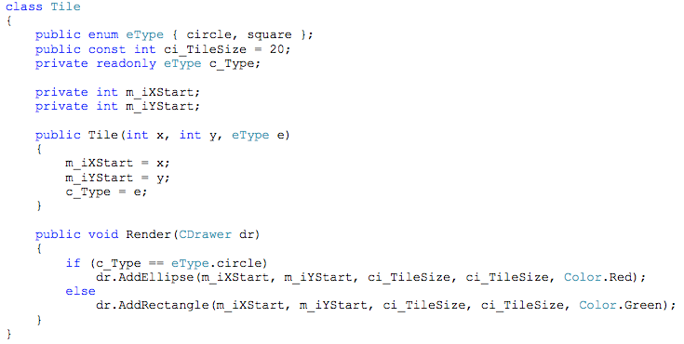
Overriding Equals

Slide 47
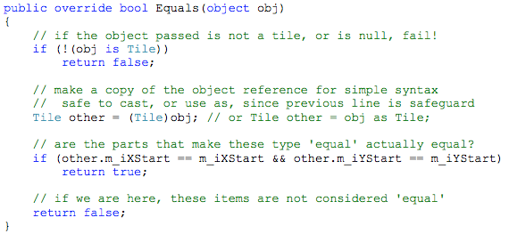
Overriding Equals

Slide 48
Overriding Equals
The is keyword is used to determine if the object provided is actually the same type as the class type.
The is keyword will return false if the type is not correct, or is null.
If the two objects are considered logically the same, the function returns true, otherwise it returns false.

Slide 49

GetHashCode
If Equals is overridden, users of the class will expect that GetHashCode will also be overridden.
If you don't intend to use GetHashCode, it is acceptable to return a value of 1.
The use of GetHashCode will be discussed later in the course.

Slide 50
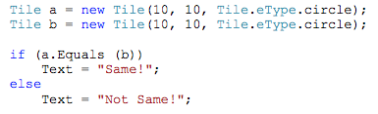
Equals
Once the Equals override has been created, it can be used to compare two objects.

Slide 51
IComparable
Sorting containers of objects (example: arrays) is a very common requirement in programming.
It would be fairly easy to write a method that could be used to compare two instances of a class, but without direction, everyone could implement the method differently.
Interfaces describe elements of a behavior, and what they should look like.
Including the IComparable interface in our classes forces us to create a structured and well defined public interface for performing comparisons.
The framework is aware of the IComparable interface, and if we implement it correctly, we can use the built in sorting methods.

Slide 52
IComparable
To include the IComparable interface in a class, you place it after a colon, after the class name.

Slide 53
IComparable
Using the IComparable interface forms a contract that you must honor by defining whatever methods that the IComparable interface requires.
The interface requires that you implement a method named CompareTo() that will return an int indicating the order of this and the provided instance.
The CompareTo() method receives one parameter which is of type object.
The return value has three meanings:
return value of -1 means that this instance is less than the object
return value of 0 means that this instance is equal to the object
return value of 1 means that this instance is greater than the object

Slide 54
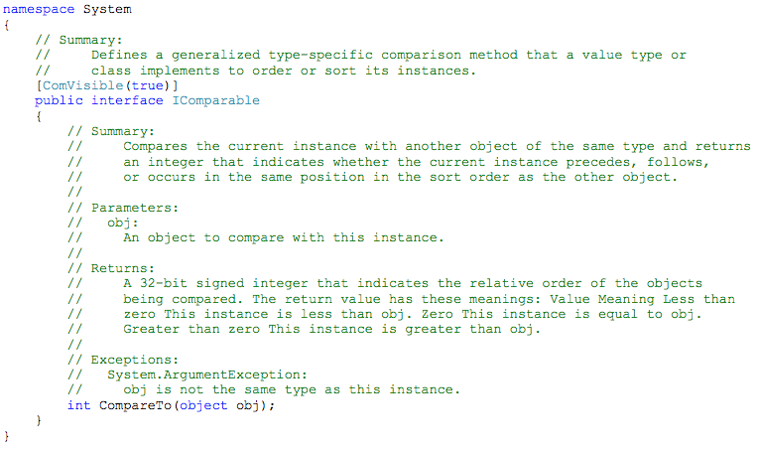
IComparable

Slide 55
CompareTo
The CompareTo() method is written to first check to ensure that the argument provided is of the same type as the invoking instance.
If the type of the argument is incorrect, an ArgumentException is thrown.
If the argument is of the correct type, then -1, 0, or 1 is returned based on a comparison between the two objects.

Slide 56
CompareTo Example
The following class, CNumber, has been created to contain a single random int in the range of 0 to 99.
When an instance of CNumber is created, the integer field is initialized to a random number by the default constructor.
The main program will create an array of CNumber instances, display the values in each object, then sort and display the results.

Slide 57
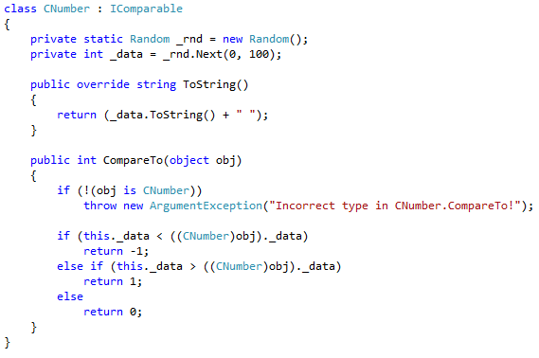
CompareTo Example

Slide 58
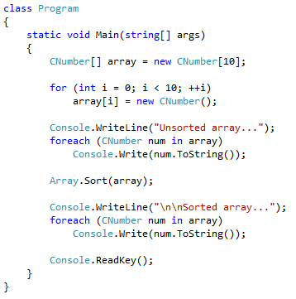
CompareTo Example

